Slide 1
Transfer Journey
Mapping template
and impact measurement
Liat Rogel, Service Designer, Urbact Expert

Slide 2
Transfer Journey Mapping
Phases in time
ACTIONS
Starting Point
Stakeholders
End Point
Indicators

Slide 3
Transfer Journey Mapping - Starting Point (Template)
1. Evaluation
In the box below, please provide a short description of:
-why you joined the transfer network to start with
-what were your expectations
Gdansk
We joined the transfer network because...
The main challenge for Gdansk is the execution of inhibitants’ rights to the city related to common goods and common management of public spaces and improving the quality of local democracy. On one hand there is a lot of active citizens who get involved in the policy, decision making processes but on the other hand they are not ready to take over the responsibility to manage common goods in a way which will secure the interests of all groups of citizens. The particular interests usually dominate over the common good. The implementation of principles of self-management, cooperation and mutualism, and strengthening individual and collective responsibility makes a big challenge but is also a big chance for positive social change.
2. Our expectations were...
To learn from already existing and functioning models of pooling urban commons, learning about the factors of success and the conditions that determine the successful co-management of shared places, obtaining support in the proper conduct of participatory processes in decision making and reaching common solutions on the neighbourhood level
Notes:
Just need a little editing and focus.
“We were really impressed by the Naples example and it inspired us to this of how we could translate this in a Polish context”

Slide 4
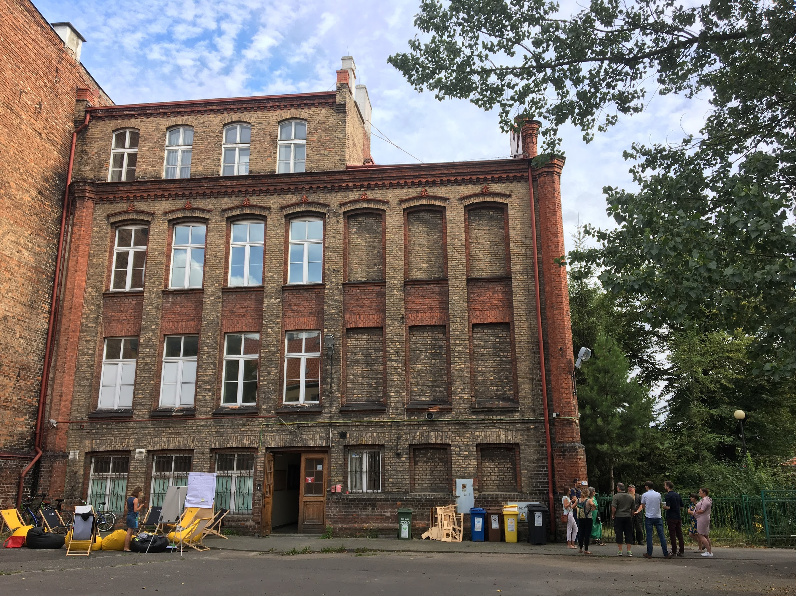
Transfer Journey Mapping - Starting Point (Template)
2. Assets
In the spaces below, please provide images of your STARTING asset(s) along with a short description (ex. Type of building, etc.).
1
2
PLACE PICTURE(S) OF YOUR ASSETS HERE
Add neighbourhood houses
Historical school building (primary school, technical school, recently a private college). 1,200 m2 of space with a large yard. Needs renovation (the main problem is no elevator).
Describe that they arrived later and why
Notes:
Add: a map (maybe Google map) of the neighborhood houses with points for each house around Gdansk, as well as individual pictures of one or two houses to show detail
We were first thinking to open this abandoned building to the public and allow citizens to manage themselves, with the development of a way for them to govern themselves. However, when we actually started, some other assets appeared. For example, the neighborhood houses and working with them to transfer this NGO model of governance to neighborhood houses. We were influenced by the Barcelona models and realized that neighborhood houses also exist in a similar way to Barcelona and this is why we decided to include them in the process. It was during the creation of the transfer plan that we made this discovery.

Slide 5
Transfer Journey Mapping - Starting Point (Template)
In the box below, please provide a short description of your top 4 challenges.
3. Challenges
Challenge #1:
Challenge #2:
Challenge #3:
Challenge #4:
To build a community around the physical space ready for co-management
To tackle legal challenges: the transfer needs legal hacking to be properly carried out;
Renovation of Dolna Brama 8 building and forming a sustainable model for using it by the local community
Popularization of the ideology of commons and fostering the common understanding of commons.

Slide 6
Transfer Journey Mapping - Starting Point (Template)
4. Policy
In the box below, please write a short description of your starting point in terms of policy.
Many regulations scattered over various policies and documents:
participatory budget
legal framework for cooperation with civil society organizations
citizen assemblies
premises for NGOs
urban regeneration plans
advisory bodies and participation groups
Commons?
Type an ‘X’ to indicate Yes or No
YES
In the box to the right, briefly describe how innovative your policy was.
We did not have a special policy dedicated to commons.
commons is a rather new concept in our country
NO
x
Citizen participation?
Type an ‘X’ to indicate Yes or No
YES
In the box to the right, briefly describe how innovative your policy was.
x
Applied principle of co-creation of local public policies
Several policies related to citizen participation, as call for proposal for NGO and contracts for social services carried out by civil organizations,
participatory budget.
Main innovative policies are: citizens assemblies and social innovation funds
NO
-

Slide 7
Transfer Journey Mapping - Starting Point (Template)
In the box below, please briefly describe how the ULG was first structured. Include references to the 5 types of stakeholders involved.
5. ULG
At first, we structured our ULG...
Policymakers, Public actors, private operators, social organizations, knowledge institutions, urban commoners (i.e. informal groups, civic entrepreneurs, city makers, social innovators, etc.).
Public actors, local activists, NGOs, freelancers, independent experts, social innovators, think tank, FAB LAB , voluntary service center
Notes:
In the beginning, out core ULG members was related to the first building. We asked innovators and other NGOs to join and also our makers movement to join the process. But this building is composed of two smaller buildings, one of which is a small “hub lab” and it made it difficult because the members of this lab are quite close to other representatives of the makers movement. But Christian helped us understand that we needed a creative lawyer, which don’t exist in Gdansk, they are there to protect our city from mistakes. We asked members of our NGO, which is a kind of think tank.

Slide 8
Transfer Journey Mapping - Starting Point (Template)
Branding companies, could be part of ULG?
Difficult to involve Investors
In the table below, please briefly describe how the 5 types of stakeholders were involved and their impact.
**TIP: Refer back to the previous files you created on this topic**
5. ULG
Need to involve creative lawyers internally
Stakeholder Type | How was the stakeholder involved? | What was the impact/influence?
Public | Running the processes, organization of the ULG meetings | Input to co-creation of the transfer plan and new policy for civic managements of commons
Private | Work on preparing a process of adaptation of Community Balance for the Gdansk’s need for self- assessment tool of neighbour houses | Impact on the final shape of the tool
Knowledge/ Institutions | Making the recognition of the existing legal frameworks and solutions useful for the civic management of commons | Advisory input into the concept for new policy for civic management of commons, assessment of the worthiness of various legislation acts
Social Organizations | Participation in the meetings of ULG, designing future use of the asset, temporary users of the asset | Input to co-creation of the transfer plan and ,the concept for a new policy for civic managements of commons,
Commoners/ Civic/ Innovators | Participation in the meetings of ULG, ideas generation, designing future use of the asset | Input to co-creation of the transfer plan and ,the concept for a new policy for civic managements of commons, users of the asset
Notes:
We don’t have anyone who is a typical investor, we didn’t manage to join this sort of member. There are some internal reasons: this is part of the competencies of the other part of the city, and unfortunately, the cooperation between these departments is very low because they don’t understand the role of the commons. We have only one “observer” not member from the private sector, a founder of a private equity investment firm. He is a friend, advisor observer, but not a member of the ULG. he offers advice but not deeply involved.
We made a benchmark of the branding companies that could be invovled deeply in the process, not just for the money but we wanted them to be involved as friends of the process and engage them more instead of just having them do the work. Now we are in the stage of preparing a contract because we must be transparent before any more work is done.

Slide 9
Transfer Journey Mapping - Starting Point (Template)
Mature
6. Objectives
In the box below, please briefly describe your starting objectives for the project.
Objective #1:
Objective #2:
Objective #3:
Objective #4:
Create legal framework for commons:
If local law requires a change - preparation of a change project and presenting it to the City Council of Gdańsk,
If national law does not allow for the implementation of GP - preparation of recommendations for changes
Second level concerns building a community around the physical space ready for co-management and taking responsibility of the place according to the principle of public- civil partnership.
Renovation of the Dolna Brama 8 building
Creating sustainable financial model
Notes:
Remove challenges from descriptions

Slide 10
Transfer Journey Mapping - Starting Point
Gdańsk
weak | moderate | strong
 | X spaces/assets | X policy level
 |  | x
 | x
 |  | x
 | x
Co-Gov
Enabling State
Soc&Econ Pooling
Experimentalism
Tech Justice

Slide 11
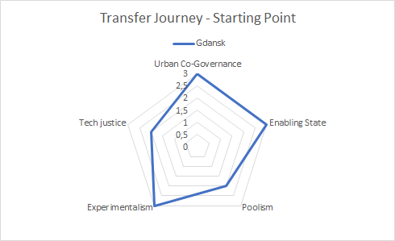

Slide 12
Transfer Journey Mapping - Actions
Phases/Time
Not all stakeholders acted at the same moment
Sometimes the same action happen together
Actions are of your ULG but main Transnational activities should be included
Think about the most relevant actions
You may add dots with specific moments you wish to highlight
Remember the specific CivicEstate timeline including transnational meetings, this may help you to remember better your own journey.
Public
What actions were made by this stakeholder?
What actions were made by this stakeholder?
1
Private
What actions were made by this stakeholder?
What actions were made by this stakeholder?
Knowledge institutions
What actions were made by this stakeholder?
What actions were made by this stakeholder?
Stakeholders
Social organizations
What actions were made by this stakeholder?
What actions were made by this stakeholder?
2
commoners/civic/
innovators
What actions were made by this stakeholder?
What actions were made by this stakeholder?

Slide 13
Transfer Journey Mapping
Starting Point (0-3 Months)
In the boxes below, briefly describe the actions done by each stakeholder during this phase, using just a few words.
Phases/Time (0-3 Months)
Public
LWAG & ULG creation
Transfer preparations
What actions were made by this stakeholder?
See above, difficulty to involve
Private
What actions were made by this stakeholder?
What actions were made by this stakeholder?
Knowledge institutions
Participating in ULG meetings
NGO, think tanks - not university
What actions were made by this stakeholder?
Stakeholders
Social organizations
Participating in ULG meetings
What actions were made by this stakeholder?
commoners/civic/
innovators
Participating in ULG meetings
What actions were made by this stakeholder?
00 - 03 Months
(Use if you have extra phases)

Slide 14
Transfer Journey Mapping
Transfer Learning Period to Transfer State Report (4-12 Months)
In the boxes below, briefly describe the actions done by each stakeholder during this phase, using just a few words.
Phases/Time (4-12 Months)
Public
Space use design - facilitation , documentation of the process, coordination, Participating in ULG meetings
Legal research - defining the scope of the study
Documentation for renovation
After ghent meeting, lawyer in the Ghent meeting
Private
What actions were made by this stakeholder?
What actions were made by this stakeholder?
What actions were made by this stakeholder?
Knowledge institutions
Legal research - conducting research, Participating in ULG meetings
Participating in transnacional meeting (Ghent)
What actions were made by this stakeholder?
Stakeholders
Social organizations
Legal research - insights and feedback, Participating in ULG meetings
Space use design
ideation, needs assesment, networking, outreach, Participating in ULG meetings
What actions were made by this stakeholder?
commoners/civic/
innovators
Space use design
Ideation, Participating in ULG meetings
Legal framework cocreation - creating an outline of the regulations for commons, Participating in ULG meetings
What actions were made by this stakeholder?
4 - 8 Months
9 - 12 Months
(Use if you have extra phases)

Slide 15
In the boxes below, briefly describe the actions done by each stakeholder during this phase, using just a few words.
Transfer Journey Mapping
Learning Period and Training to Sharing (13-24 Months)
Phases/Time (13-24 Months)
Procedure with the building take long and so deciding to work on the neighbourhood community houses
More difficult to involve ULG
Public
Community Balance transfer, Participating in ULG meetings
What actions were made by this stakeholder?
What actions were made by this stakeholder?
The interest of ULG is getting low because of the timing. It is important to keep them engaged.
Asset branding design
Private
What actions were made by this stakeholder?
What actions were made by this stakeholder?
Knowledge institutions
Community Balance transfer - methodology, Participating in ULG meetings
What actions were made by this stakeholder?
What actions were made by this stakeholder?
Stakeholders
Plan B was the outside of the building affected by COVID pandemic
Social organizations
Community Balance transfer - insight, Participating in ULG meetings
What actions were made by this stakeholder?
What actions were made by this stakeholder?
commoners/civic/
innovators
Community Balance transfer - insight, Participating in ULG meetings
What actions were made by this stakeholder?
What actions were made by this stakeholder?
13 - 16 Months
17 - 20 Months
(Use if you have extra phases)
Notes:
Involve the change of mayor and also indicate how it’s changed. Some formal procedures with the building lasted so long that we decided to do something else in the meantime and focused on the neighborhood community houses. Also, because of the long process, the ULG members’ interests lowered significantly, but we think we will rebuild this interest now.
Btwn March and July, we were totally focused on Co-vid actions. We were creating several tools to combat co-vid, but it’s worth to say that this had a positive impact on donating efforts, creating coalitions and cooperation that was impossible before. We announced invitations to make offers with the city and negotiating with the coalitions and how to combine them. We’ve noticed a huge progress in collaborative work within the NGO sector.

Slide 16
In the boxes below, briefly describe the actions done by each stakeholder during this phase, using just a few words.
Transfer Journey Mapping
Learning Period and Training to Sharing (13-24 Months)
Phases/Time (13-24 Months)
Public
What actions were made by this stakeholder?
What actions were made by this stakeholder?
Horizon 2020, March 2020
Private
What actions were made by this stakeholder?
What actions were made by this stakeholder?
Knowledge institutions
What actions were made by this stakeholder?
More autonomous in decision making
What actions were made by this stakeholder?
Stakeholders
COVID has positive impact on organisation
Donations, fostering coalitions, collective actions, co- financed
Social organizations
What actions were made by this stakeholder?
What actions were made by this stakeholder?
commoners/civic/
innovators
What actions were made by this stakeholder?
What actions were made by this stakeholder?
21 - 24 Months
(Use if you have extra phases)

Slide 17
In the boxes below, briefly describe the actions done by each stakeholder during this phase, using just a few words.
Transfer Journey Mapping
Sharing Period (25-27 Months) & End Point (28-30)
Phases/Time (25-28; 28-30 Months)
Public
What actions were made by this stakeholder?
What actions were made by this stakeholder?
What actions were made by this stakeholder?
Private
What actions were made by this stakeholder?
What actions were made by this stakeholder?
What actions were made by this stakeholder?
Knowledge institutions
What actions were made by this stakeholder?
What actions were made by this stakeholder?
What actions were made by this stakeholder?
Stakeholders
Social organizations
What actions were made by this stakeholder?
What actions were made by this stakeholder?
What actions were made by this stakeholder?
commoners/civic/
innovators
What actions were made by this stakeholder?
What actions were made by this stakeholder?
What actions were made by this stakeholder?
25 - 27 Months
28-30 Months
(Use if you have extra phases)
Notes:
Remember:
Not all stakeholders acted at the same moment
Sometimes the same action happen together
Actions are of your ULG but main Transnational activities should be included
Think about the most relevant actions
You may add dots with specific moments you wish to highlight

Slide 18
Transfer Journey Mapping - Indicators
Co-Gov
Co-Governance refers to the presence or absence of a self-, shared, collaborative or polycentric organization for the governance of the commons in cities;
Enabling State
Enabling State expresses the role of the State in the governance of the commons and identifies the characteristics of an enabling state that facilitates collective actions for the commons;
Social and Economic Pooling is the distinction between an urban governance scheme based on co-governance, and an urban governance scheme based on urban pools, This variable is maximized when civic actors adopt a more entrepreneurial approach;
Soc&Econ Pooling
Experimentalism
Experimentalism is the presence of an adaptive, place-based and iterative approach to design legal and policy innovations that enable the urban commons;
Tech Justice
Tech Justice highlights the potentiality of digital infrastructures and access to technology in particular for vulnerable people and communities as an enabling factor of collaboration, local development and social cohesion.

Slide 19
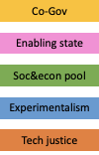
Transfer Journey Mapping - Measurement (Done in Meeting)
Phases/Time
What actions were made by this stakeholder?
What actions were made by this stakeholder?
What actions were made by this stakeholder?
Stakeholders
Public
4
High
Indicators
Moderate
Weak
Notes:
This will be completed during the actual meeting.

Slide 20
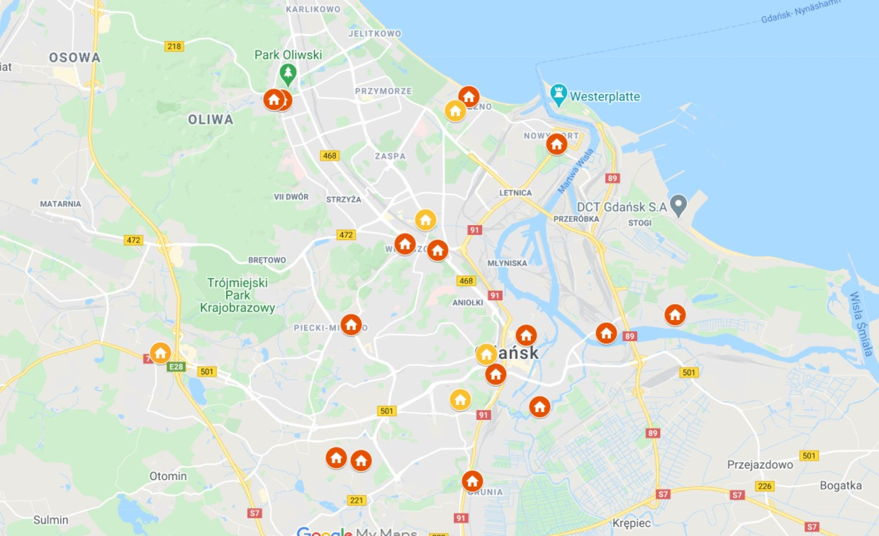
Transfer Journey Mapping - End Point (template)
In the spaces below, please provide images of your ENDING asset(s) along with a short description (ex. Type of building, etc.).
Assets
PLACE PICTURE(S) OF YOUR ASSETS HERE
PLACE PICTURE(S) OF YOUR ASSETS HERE
Historical school building (primary school, technical school, recently a private college). 1,200 m2 of space with a large yard. Needs renovation (the main problem is no elevator).
a network of neighborhood houses and clubs

Slide 21
Transfer Journey Mapping - End Point (template)
Change
During the meeting, reflect on the 4 challenges you described in Slide 5. How did you meet these challenges? Describe your successful strategies.
Challenge #1:
Challenge #2:
Challenge #3:
Challenge #4:
Building a community based on local leaders and local residents
The invitation to cooperate with lawyers from outside the city hall was a success. They were our legal hackers
cooperation with experts in the renovation of historic buildings
Still to be done
Notes:
Working with people that are already active, the pandemic created difficulties in relationships
Second challenge was the main one, no creative laws- very active, pro-bono for social initiatives, they will be responsible for conference
Social development department, we know how to work and we have contact with NGOs and other organisations
Still need to find half of the investment
With the new deputy mayor will start and be responsible for the process
First strategy on the 4th is the conference, dedicate a study and a phd work - -idea about private properties

Slide 22
Transfer Journey Mapping - Ending Point (Template)
Policy Changes
During the meeting in the boxes below, please write a short description of how your policy changed throughout the journey in terms of Commons and Citizen Participation.
We still do not have a single policy dedicated to commons, but we have analyzed all activities in this area and collected them into one document. We plan to combine participatory activities and those dedicated commons in one place - Centrum Dolna Brama
Incubator - and set of tools and tricks
Commons?
Type an ‘X’ to indicate Yes or No
YES
-
In our case it will be innovative to combine activities in one place in the Dolna Brama Centre - despite the dispersion of these issues in various documents
NO
x
Citizen participation?
Type an ‘X’ to indicate Yes or No
YES
x
In our case it will be innovative to combine activities in one place in the center of the lower gate - despite the dispersion of these issues in various documents
NO
-
Notes:
New tool for the district council, will ease call for proposals, these connects to the project even if it is not directly related. We involve other city councillors and we see them doing things which go in the direction

Slide 23
Transfer Journey Mapping - Ending Point (Template)
ULG
Changes
During the meeting in the box below, please briefly describe how the ULG was structured toward the end. Include references to the 5 types of stakeholders involved.
In the end we structured our ULG...
Due to difficulties, mainly this year, the ULG consists mainly of representatives of the social sector, researchers, and us clerks from different departments. We have still not managed to attract the interest of the private sector
Our ending ULG involved stakeholders in the following ways:
Public:
Private:
Knowledge/Institutions
Social Organizations:
Commoners/Civic/Innovators:
DESCRIBE HOW THEY WERE INVOLVED HERE….
DESCRIBE HOW THEY WERE INVOLVED HERE...
DESCRIBE HOW THEY WERE INVOLVED HERE...
DESCRIBE HOW THEY WERE INVOLVED HERE...
DESCRIBE HOW THEY WERE INVOLVED HERE...

Slide 24
Transfer Journey Mapping - Ending Point (Template)
During the meeting in the box below, please briefly evaluate the success of your objectives described in Slide 11 for the project.
Mature
Objectives
Objective #1:
Objective #2:
Objective #3:
Objective #4:
Creating one legal framework for this time is very difficult, instead we will put together a set of legal tricks on how to smuggle commons rules into regular operation
After many hardships, we need to restart the community building process again
In progress, but not without many difficulties
Still to be done

Slide 25
Transfer Journey Mapping - End Point (template)
During the meeting, reflect on the 5 indicators and their development through the project.
-What changed and why did they change?
-What do you think of your ending point?
Evaluation
Regarding the 5 indicators, our transfer journey developed in the following ways:
Indicator | How did this indicator develop? Why? | Weak, Moderate, or Strong?
Co-Gov | In the spirit of the city and in all activities | Strong
Enabling State | Brokers about different sectors. There are special paragraphs for ngos how to apply for municipal locations. We need to make it more open. | Strong
Soc&econ pool | Mindset changes also from city council members | moderate
Experimentalism | Especially in our department, we try out, we launch new projects. Also now testing the index. Social innovation fund, also tested | strong
Tech justice | Just started to think about tool accessibility. | moderate
DESCRIBE WHAT YOU THINK OF YOUR END POINT HERE…
We feel in the same place in term of indicators. We are strong on co-gov. The tool we are developing will be given to the centres. We are Brokers.

