Slide 1
Transfer Journey
Mapping template
and impact measurement
Liat Rogel, Service Designer, Urbact Expert

Slide 2
Transfer Journey Mapping
Phases in time
ACTIONS
Starting Point
Stakeholders
End Point
Indicators

Slide 3
Transfer Journey Mapping - Starting Point (Template)
In the box below, please provide a short description of:
-why you joined the transfer network to start with
-what were your expectations
1. Evaluation
Amsterdam
We joined the transfer network because...
The city council and the board of mayor and aldermen have a strong desire to form a new bond, like the city of Naples did, with citizens and to give them more freedom to ‘use’ the city and the assets the city provides. To become a ‘ço-city’ and develop innovative ways of working together with citizens on creating public value. In this regard the ancient Italian legal way of “civic use” that was used to institutionalize the informal/social management of these buildings is very interesting for the city of Amsterdam. This as well as the innovative dialogue between administration and citizens and the process of juridical co-creation that was build. The city of Amsterdam has a strong believe that the new form of participatory governance that was developed and the civic use of the city’s assets can be the same driving force for the social and economic development of the city as it was in the city of Naples.
2. Our expectations were…
We hoped to be inspired by other cities and practices and by sharing legal tools and instruments. How to really become a co-city?

Slide 4
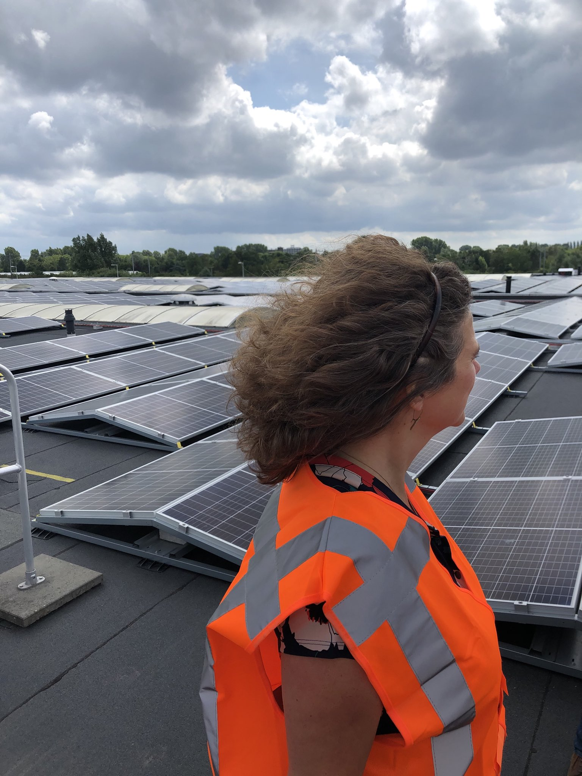
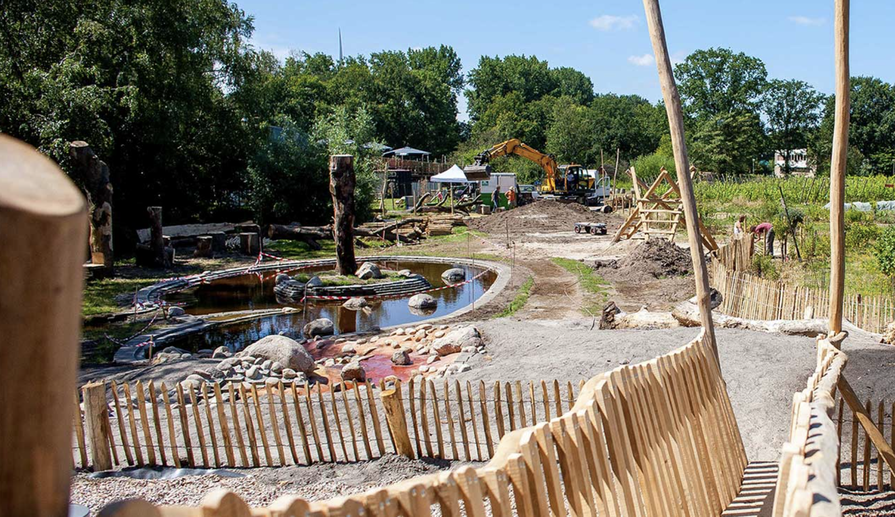
Transfer Journey Mapping - Starting Point (Template)
2. Assets
In the spaces below, please provide images of your STARTING asset(s) along with a short description (ex. Type of building, etc.).
Link to pics/asset: https://noordoogst.org/
Energy as a common good and buildings, rooftops, etc. for energy commons and energydemocracy
Food as a common good and ‘free space’ for food commons and food democracy
Notes:
Pilot 2 - need another photo
Include the very first asset that was included in the application that was decided against.
For all 3→ why did you choose them in the first place?

Slide 5
Transfer Journey Mapping - Starting Point (Template)
In the box below, please provide a short description of your top 4 challenges.
3. Challenges
Challenge #1:
Challenge #2:
Challenge #3:
Challenge #4:
ULG: how to ‘organise’ a ULG in a meaningful way. How to truly involve Amsterdam residents and commoners in the ULG?
Internal organisation: how to organise the internal organisation around the project?
Knowledge/ narrative on commons: the commons are not widely known in the NL, so we face two challenges: how to talk about ‘common goods’ AND how to talk about the organisational model of the commons?
Money/ plots: how to organise finance and assets for commons?
Notes:
Challenge 1: fragile ecosystem, very difficult because you have to be aware of you who are talking to and how that might affect others. How can you make it relevant for people to donate their time?
Challenge 2: Derrik being ill. There are only two legal officers on the team, so it was difficult to create a stable team.
Challenge 3: No one knows what commons are, no one likes the word “common” it is widely misunderstood.
Challenge 4: Clear

Slide 6
Transfer Journey Mapping - Starting Point (Template)
4. Policy
In the box below, please write a short description of your starting point in terms of policy.
We want to form a new bond with citizens, acknowledge the commons and make way for them in a practical and inspirational way.
Commons?
Type an ‘X’ to indicate Yes or No
YES
In the box to the right, briefly describe how innovative your policy was.
X
Firstly, we (are in the process of) changing the narrative of the commons; acknowledging common goods. Secondly we are supporting the organisational model of the commons. This is ‘easier’ when there’s an existing legal framework - like the citizen energy community or ‘wooncooperatie’ (citizen housing cooporation).
NO
-
Citizen participation?
Type an ‘X’ to indicate Yes or No
YES
In the box to the right, briefly describe how innovative your policy was.
X
We are working towards a ‘co-city desk’, very innovative since it will acknowledge the commons as a ‘sector’ with special support and policy
NO
-
Notes:
Add names of specific projects could be useful to add information onto what Amerstam already had before starting Civic eState. Could link to earlier policies/initiatives.

Slide 7
Transfer Journey Mapping - Starting Point (Template)
In the box below, please briefly describe how the ULG was first structured. Include references to the 5 types of stakeholders involved.
5. ULG
At first, we structured our ULG...
We structured our ULG very informal to start with, and chose to ‘join’ events rather than ‘invite’ people to our events. The ULG is now getting more organised. Hopefully we can continue the ULG in a ‘commission’ that will support the ‘co-city desk’ as an independent advisor after this project.

Slide 8
Transfer Journey Mapping - Starting Point (Template)
In the table below, please briefly describe how the 5 types of stakeholders were involved and their impact.
**TIP: Refer back to the previous files you created on this topic**
5. ULG
Stakeholder Type | How was the stakeholder involved? | What was the impact/influence?
Public | Research and many ‘talks and walks’ | Strengthening the network, more knowledge
Private | Small social businesses and social entrepreneurs are involved | Strengthening the network
Knowledge/ Institutions | Several meetings and ‘coffees’ to see how to cooperate | More knowledge and innovation
Social Organizations | We asked a network organisation on the commons to do research on perspectives for the public to enhance the commons | More knowledge of needs and networks
Commoners/ Civic/ Innovators | We asked artists to make a ‘whole commons catalog’ to show the ‘perspective of the commons on the city’ | Broadening the network, sharing the stories, building the narrative
Notes:
Public - commons and legal
Private - social entrepreneur already in contact with the municipality
Knowledge - Uni of Amsterdam, Hague School, we had one workshop with them and lots of talks
Social Orgs - Commons Network was asked to do research
Commoners - asked to do research

Slide 9
Transfer Journey Mapping - Starting Point (Template)
Mature
6. Objectives
In the box below, please briefly describe your starting objectives for the project.
Objective #1:
Objective #2:
Objective #3:
Objective #4:
Strengthening the Amsterdam ecosystem of commons and commoners
Sharing of (International) experiences on needs and possibilities
Research on (potential) policy measures
Enriching the narrative of democratisation
Notes:
By acknowledging commons you strengthen the network, but there is a current network based on scarcity and competition. We wanted to transition into an ecosystem of plenty instead, maybe next year. We need to build an economic infrastructure to support innovation and new projects. We are not there yet, for example, we only have one German bank

Slide 10
Transfer Journey Mapping - Starting Point
Amsterdam
weak | Moderate | Strong
 | x
 | x | x
 | x
 |  | x
 | x
Co-Gov
Enabling State
Soc&Econ Pooling
Experimentalism
Tech Justice
Notes:
One of they key elements that we aligned was the financial part, since the beginning we knew we needed to step up and at first, there was a very coherent plan.
Co-Gov → based on the number of stakeholders that are involved
Enabling state → were you able to enable the relationship between different external actors, this would be an indication of a strong enabling state

Slide 11
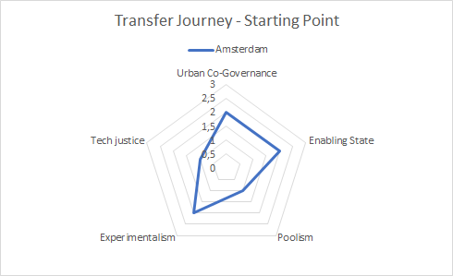

Slide 12
Transfer Journey Mapping - Actions
Phases/Time
Not all stakeholders acted at the same moment
Sometimes the same action happen together
Actions are of your ULG but main Transnational activities should be included
Think about the most relevant actions
You may add dots with specific moments you wish to highlight
Remember the specific CivicEstate timeline including transnational meetings, this may help you to remember better your own journey.
Public
What actions were made by this stakeholder?
What actions were made by this stakeholder?
1
Private
What actions were made by this stakeholder?
What actions were made by this stakeholder?
Knowledge institutions
What actions were made by this stakeholder?
What actions were made by this stakeholder?
Stakeholders
Social organizations
What actions were made by this stakeholder?
What actions were made by this stakeholder?
2
commoners/civic/
innovators
What actions were made by this stakeholder?
What actions were made by this stakeholder?

Slide 13
Transfer Journey Mapping
Starting Point (0-3 Months)
In the boxes below, briefly describe the actions done by each stakeholder during this phase, using just a few words.
Phases/Time (0-3 Months)
Public
First ecosystem meetings
What actions were made by this stakeholder?
Private
What actions were made by this stakeholder?
Knowledge institutions
Several projects and PHDs on commons in Amsterdam
What actions were made by this stakeholder?
Stakeholders
Social organizations
What actions were made by this stakeholder?
commoners/civic/
innovators
Daily practice of commoning
What actions were made by this stakeholder?
00 - 03 Months
(Use if you have extra phases)
Notes:
Remember:
Not all stakeholders acted at the same moment
Sometimes the same action happen together
Actions are of your ULG but main Transnational activities should be included
Think about the most relevant actions
You may add dots with specific moments you wish to highlight

Slide 14
Transfer Journey Mapping
Transfer Learning Period to Transfer State Report (4-12 Months)
In the boxes below, briefly describe the actions done by each stakeholder during this phase, using just a few words.
Phases/Time (4-12 Months)
Public
Research / stakeholder mapping/ codesigning of project with stakeholders / organising ULGs
Research / codesigning of project with stakeholders / organising ULGs / first drafts of policies / organising workshops
What actions were made by this stakeholder?
Private
What actions were made by this stakeholder?
Knowledge institutions
First talks
Codesigning project
What actions were made by this stakeholder?
Stakeholders
Social organizations
Research
Research and participation in ULGs and network meetings
What actions were made by this stakeholder?
commoners/civic/
innovators
Participation in ULGs, organising events
Participation in ULGs, organising events, reviewing policies,
What actions were made by this stakeholder?
4 - 8 Months
9 - 12 Months
(Use if you have extra phases)
Notes:
Before Natalie, it was more difficult to involve private institutions because there wasn’t that mindset.
We are co-designing with FAR a research project with a professional master.
First financing meeting with 30 representatives of private financial investors, banks, organizations, etc.

Slide 15
Transfer Journey Mapping - Starting Point
Amsterdam
weak | Moderate | Strong
 |  | x
 |  | x
 | x
 |  | x
 | x
Co-Gov
Enabling State
Soc&Econ Pooling
Experimentalism
Tech Justice
Notes:
One of they key elements that we aligned was the financial part, since the beginning we knew we needed to step up and at first, there was a very coherent plan

Slide 16
In the boxes below, briefly describe the actions done by each stakeholder during this phase, using just a few words.
Transfer Journey Mapping
Learning Period and Training to Sharing (13-24 Months)
Phases/Time (13-24 Months)
Public
Research / organising ULGs / codesigning possible policies / organising workshops / organising whole commons catalog
Communication about project / organising ULGs / codesigning possible policies / organising workshops / publishing whole commons catalog
What actions were made by this stakeholder?
Private
Talks and events with several funds and banks and financial institutions on ‘financing commons’
Talks with EIB
What actions were made by this stakeholder?
Knowledge institutions
Participation in events and ULGs
Participation in events and ULGs, organising own events on commons
What actions were made by this stakeholder?
Stakeholders
Social organizations
Research and participation in ULGs and network meetings
Research and participation in ULGs and network meetings
What actions were made by this stakeholder?
commoners/civic/
innovators
Participation in ULGs, organising events, reviewing policies,
Participation in ULGs, co-organising events, reviewing policies, talks about the legal framework, cooperation amongst commoners
What actions were made by this stakeholder?
13 - 16 Months
17 - 20 Months
(Use if you have extra phases)
Notes:
Notes: more specific about kinds of events that were done, for instance a specific meeting that was more influential than others and so on.

Slide 17
In the boxes below, briefly describe the actions done by each stakeholder during this phase, using just a few words.
Transfer Journey Mapping
Learning Period and Training to Sharing (13-24 Months)
Phases/Time (13-24 Months)
Public
Communication about project / organising ULGs / codesigning possible policies / organising workshops / movie on Amsterdam commons/ desseminating results
What actions were made by this stakeholder?
Private
Ongoing and new talks with banks and funds
What actions were made by this stakeholder?
Knowledge institutions
Participation in events and ULGs, organising own events
What actions were made by this stakeholder?
Stakeholders
Social organizations
Dissemination of results and participation in ULGs and network meetings
What actions were made by this stakeholder?
commoners/civic/
innovators
Participation in ULGs, organising events, reviewing policies,
What actions were made by this stakeholder?
21 - 24 Months
(Use if you have extra phases)
Notes:
Remember:
Not all stakeholders acted at the same moment
Sometimes the same action happen together
Actions are of your ULG but main Transnational activities should be included
Think about the most relevant actions
You may add dots with specific moments you wish to highlight

Slide 18
In the boxes below, briefly describe the actions done by each stakeholder during this phase, using just a few words.
Transfer Journey Mapping
Sharing Period (25-27 Months) & End Point (28-30)
Phases/Time (25-28; 28-30 Months)
Public
Communication about project / organising ULGs / organising workshops/ disseminating results
Communication about project / organising ULGs / organising workshops / disseminating results
What actions were made by this stakeholder?
Private
What actions were made by this stakeholder?
Knowledge institutions
Organising events and projects on commons; research on feasiblity of Madrid / Naples ‘model’ in Amsterdam
Organising events and projects on commons; research on feasiblity of Madrid / Naples ‘model’ in Amsterdam
What actions were made by this stakeholder?
Stakeholders
Social organizations
Organising events
Organising events
What actions were made by this stakeholder?
commoners/civic/
innovators
Organising events, co-designing co city desk
Organising events, co-designing co city desk
What actions were made by this stakeholder?
25 - 27 Months
28-30 Months
(Use if you have extra phases)
Notes:
Remember:
Not all stakeholders acted at the same moment
Sometimes the same action happen together
Actions are of your ULG but main Transnational activities should be included
Think about the most relevant actions
You may add dots with specific moments you wish to highlight

Slide 19
Transfer Journey Mapping - Indicators
Co-Gov
Co-Governance refers to the presence or absence of a self-, shared, collaborative or polycentric organization for the governance of the commons in cities;
Enabling State
Enabling State expresses the role of the State in the governance of the commons and identifies the characteristics of an enabling state that facilitates collective actions for the commons;
Social and Economic Pooling is the distinction between an urban governance scheme based on co-governance, and an urban governance scheme based on urban pools, This variable is maximized when civic actors adopt a more entrepreneurial approach;
Soc&Econ Pooling
Experimentalism
Experimentalism is the presence of an adaptive, place-based and iterative approach to design legal and policy innovations that enable the urban commons;
Tech Justice
Tech Justice highlights the potentiality of digital infrastructures and access to technology in particular for vulnerable people and communities as an enabling factor of collaboration, local development and social cohesion.

Slide 20
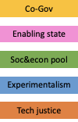
Transfer Journey Mapping - Measurement (Done in Meeting)
Phases/Time
What actions were made by this stakeholder?
What actions were made by this stakeholder?
What actions were made by this stakeholder?
Stakeholders
Public
4
High
Indicators
Moderate
Weak
Notes:
This will be completed during the actual meeting.

Slide 21
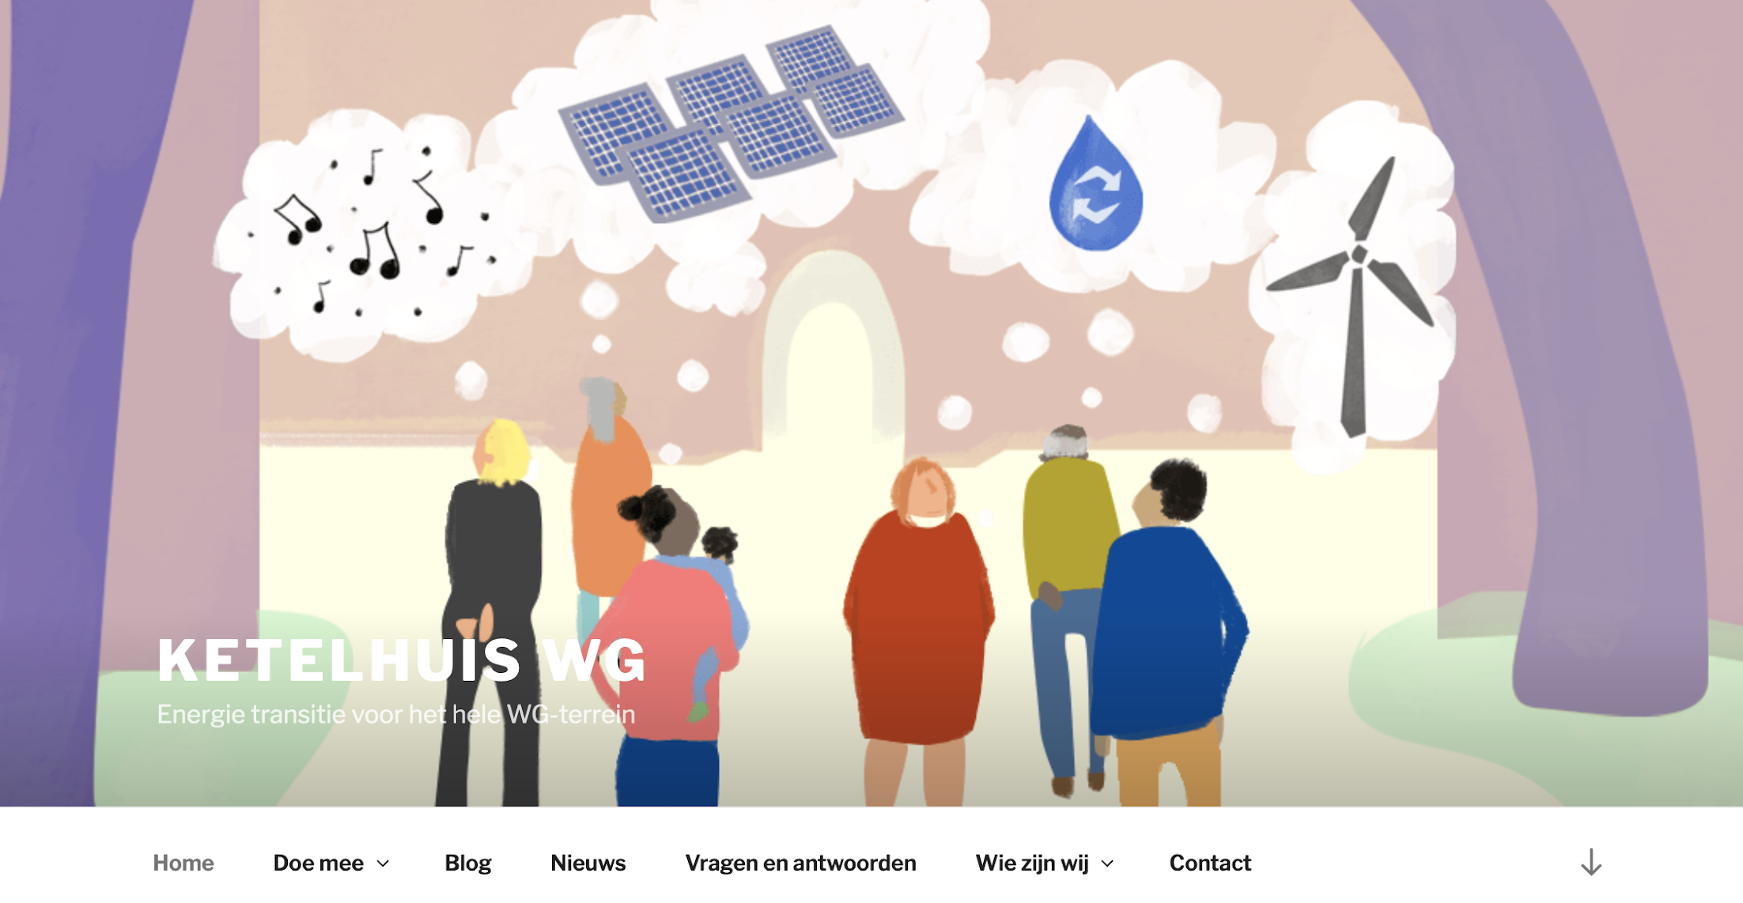
Transfer Journey Mapping - End Point (template)
In the spaces below, please provide images of your ENDING asset(s) along with a short description (ex. Type of building, etc.).
Assets
PLACE PICTURE(S) OF YOUR ASSETS HERE
PLACE PICTURE(S) OF YOUR ASSETS HERE
Fooddemocracy: kaskantine
Energy democracy: Ketelhuis WG
Notes:
There are the reference projects

Slide 22
Transfer Journey Mapping - End Point (template)
Change
During the meeting, reflect on the 4 challenges you described in Slide 5. How did you meet these challenges? Describe your successful strategies.
Challenge #1:
Challenge #2:
Challenge #3:
Challenge #4:
We try to make the ULG meetings a two-way and ‘natural’ step both in the project and in the process of participants by following their pace and interests
The internal organisation is developing into a new way of working. We’ve shared the concept policy and are developing an action plan together now with other departments and directorates
The narrative on the commons is an ongoing challenge We have the Catalog, that is really helpfull, but what we really eed is a different perspective and understanding of the city
Financing is and will be a big challenge.
Notes:
1.
2.Developing an action plan now
3.
4.

Slide 23
Transfer Journey Mapping - Ending Point (Template)
Policy Changes
During the meeting in the boxes below, please write a short description of how your policy changed throughout the journey in terms of Commons and Citizen Participation.
We’ve considered a legal framework, a policy framework and are now working on an ‘action plan’, The action plan has 2 ingredients: 1. Narrative: what are commons, how do we see the movement, and why do we want to cooperate with them. And 2: Legal: what are we going to do/ what are our local policy/legal measures. This will be an integral product- with several departments working on it.
Commons?
Type an ‘X’ to indicate Yes or No
YES
-X
We want to see the commons as a movement, and recognise and acknowledge them as such
NO
-
Citizen participation?
Type an ‘X’ to indicate Yes or No
YES
-X
We want to work together, be a co-city
NO
-
Notes:
We went from a legal framework to a policy framework to specific frameworks to an action plan. The action plan has two big parts. 1. Policy - what do we think of commons and how are we going to stimulate them and make them important. 2. Legal chapter - we have some articles in the action program that you could say is some kind of a city regulation. It’s both a policy and legal paper.
We are overall trying to maneuver and there’s a lot at stake. In the energy development, it’s a system change. Huge narrative, small steps in policy.

Slide 24
Transfer Journey Mapping - Ending Point (Template)
ULG
Changes
During the meeting in the box below, please briefly describe how the ULG was structured toward the end. Include references to the 5 types of stakeholders involved.
In the end we structured our ULG...
The ULG is an informal network/ a swarm of public servants and citymakers and social entrepreneurs and knowledge institutions. Partly invited personally, partly invited through specific citymaker networks.
Our ending ULG involved stakeholders in the following ways:
Public:
Private:
Knowledge/Institutions
Social Organizations:
Commoners/Civic/Innovators:
Formal meetings, whatsapp groups, news on intranet. etc
Invitations, whatsappgroups..
Formal meetings, invitations, whatsappgroups
Invitations, whatsapp groups.
Meetings, whatsapp groups, actively involving and following needs.
Notes:
Not as formally divided. It’s a bit informal but it works. We’ve developed an informal network. We’d like to be a network government.

Slide 25
Transfer Journey Mapping - Ending Point (Template)
During the meeting in the box below, please briefly evaluate the success of your objectives described in Slide 11 for the project.
Mature
Objectives
Objective #1:
Objective #2:
Objective #3:
Objective #4:
Ecosystem: we strengtened the ecosystem by organising events, publishing papers and creating a narrative
The sharing of good examples is vital and very helpful. Not to be overestimated how important that is.:
Policy research: we have a good idea now of what kind of policies are helpfull/ possible/ feasible/ and wanted. .
Narrative: by sharing our stories, even by organising the window of the most important bookstore in town in the commons catalog theme, we’ve enriched the narrative of local democacry a lot.
Notes:
Overall, we met our objectives in a big way.
When it comes to creating an ecosystem and experimenting and having big commons, it seems we’ve reached these and become mature

Slide 26
Transfer Journey Mapping - End Point (template)
During the meeting, reflect on the 5 indicators and their development through the project.
-What changed and why did they change?
-What do you think of your ending point?
Evaluation
Regarding the 5 indicators, our transfer journey developed in the following ways:
Indicator | How did this indicator develop? Why? | Weak, Moderate, or Strong?
Co-Gov | Covid has not made it easier but we still know how to find each other | strong
Enabling State | Amsterdam is a big, complicated organisation with lots of people working for the city of Amsterdam. You can find your allies but when it comes to budgets and finances, things become more delicate | strong
Soc&econ pool | Their is a strong network of city makers, city making civil servants, social entrepreneurs and the like. | moderate/strong
Experimentalism | We’ve worked together with other stakeholders a lot. At the moemtn we are doing research on the impact of commons on the donut model of Kate Raworth and then especially on the innercircle. | strong
Tech justice | We want to be strong on this point, but also Covid has shown - people without access to internet/ laptops/ etc.- that this is still something to addresss. Also we saw a big wave -with Covid- of commons in tech justice arise: with solidarity laptops/ refurbished laptops/ etc. by commoners otherwise involved in other types and sometimes similar sorts of projects. Like Cybersoek, Studiezalen by (nominated) Amsterdammer of the Year: http://amsterdammervanhetjaar.nl/abdelhamid-idrissi-2/ | moderate
DESCRIBE WHAT YOU THINK OF YOUR END POINT HERE...
Notes:
Should all be made to be “strong,” a question around tech justice. Tech justice would still be moderate.
Conclusion point:
Amsterdam is a big organization of a city. You can find our allies, but then when you talk about budget and finances, it becomes a bit technical. In theory, everybody’s pretty happy but we’re not there yet in practice.
LINKS:

